Slide 1


ADD TITLE
Add Subtitle

Slide 2
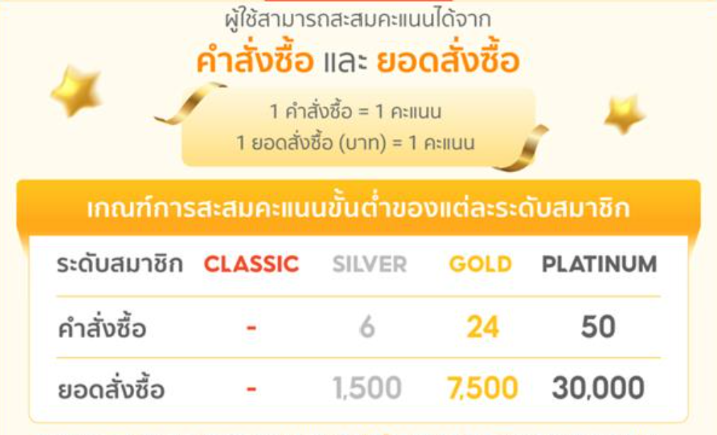
Factor for Loyalty Program
Shopee Existing Loyalty Program

Slide 3
PARAMETER

Slide 4


Parameter for Loyalty Program
Sales Order
Sales Order
Frequency
Factor: Purchased products per transaction.
Scoring and Benefits:
Classic (0 order) Earn loyalty points for each complete sales order.
Silver (6 orders) Earn loyalty points for each complete sales order.
Gold (24 orders) Double loyalty points for each complete sale.
Platinum (10+ orders) Triple loyalty points for each complete sale.

Slide 5

Parameter for Loyalty Program
Sales Amount
Sales Amount
Monetary
Factor: Purchased amount of products.
Scoring and Benefits:
Classic (THB 0) Earn loyalty points for each complete sales order.
Silver (THB 1,500) Earn loyalty points for each complete sales order.
Gold (THB 7,500) Double loyalty points for each complete sale.
Platinum (THB 30,000) Triple loyalty points for each complete sale.

Slide 6

Parameter for Loyalty Program
Product Reviews
Product Reviews
Creditability
Factor: Providing feedback and reviews on purchased products.
Scoring and Benefits:
Classic (0%-25% reviews) Earn loyalty points for each review submitted.
Silver (26%-50% reviews) Earn loyalty points for each review submitted.
Gold (51%-75% reviews) Double loyalty points for each review and a chance to win monthly gift card giveaways.
Platinum (76%-100% reviews) Triple loyalty points for each review, a free product sample with every purchase, and exclusive access to new product beta testing.

Slide 7

Parameter for Loyalty Program
Referrals
Referrals
New Customer
Factor: Successfully referring new customers to the e-commerce store.
Scoring and Benefits:
Classic (0 referrals) Earn a referral bonus for each successful referral.
Silver (1-2 referrals) Earn a referral bonus for each successful referral.
Gold (3-5 referrals) Double referral bonus and a one-time discount for the referred customer.
Platinum (+5 referrals) Triple referral bonus, a special gift for each successful referral, and a loyalty points boost for both referrer and referred customer.

Slide 8

Parameter for Loyalty Program
Social Media Engagement
Social Media Engagement
Affiliate
Factor: Active engagement with the e-commerce brand on social media platforms.
Scoring and Benefits:
Classic (0 interactions) Exclusive access to behind-the-scenes content and product sneak peeks.
Bronze (1-2 interactions) Exclusive access to behind-the-scenes content and product sneak peeks.
Silver (3-4 interactions) Exclusive discount codes for social media followers and entry into monthly social media contests.
Gold (5+ interactions) Early access to flash sales and limited-time promotions, personalized shout-outs on social media platforms.

Slide 9

Parameter for Loyalty Program
ARPU
ARPU
Monetary
Factor: Purchased amount of products divide by transaction
Scoring
0-฿500
฿501-฿1000
฿1001-฿1500
>1500

Slide 10

Parameter for Loyalty Program
CLV
CLV
Clustering Customer
Factor: Typical customer for as long as that person or account remains a client.
Scoring
Classic Group
Silver Group
Gold group
Platinum group

Slide 11
FORMULA

Slide 12
FORMULA
Score
Sales Order (15%) + Sales Amount (15%) + Product Reviews (5%) + Referrals (5%) + Social Media Engagement (5%) + ARPU (25%) + CLV (30%)
=

Slide 13
CLV

Slide 14
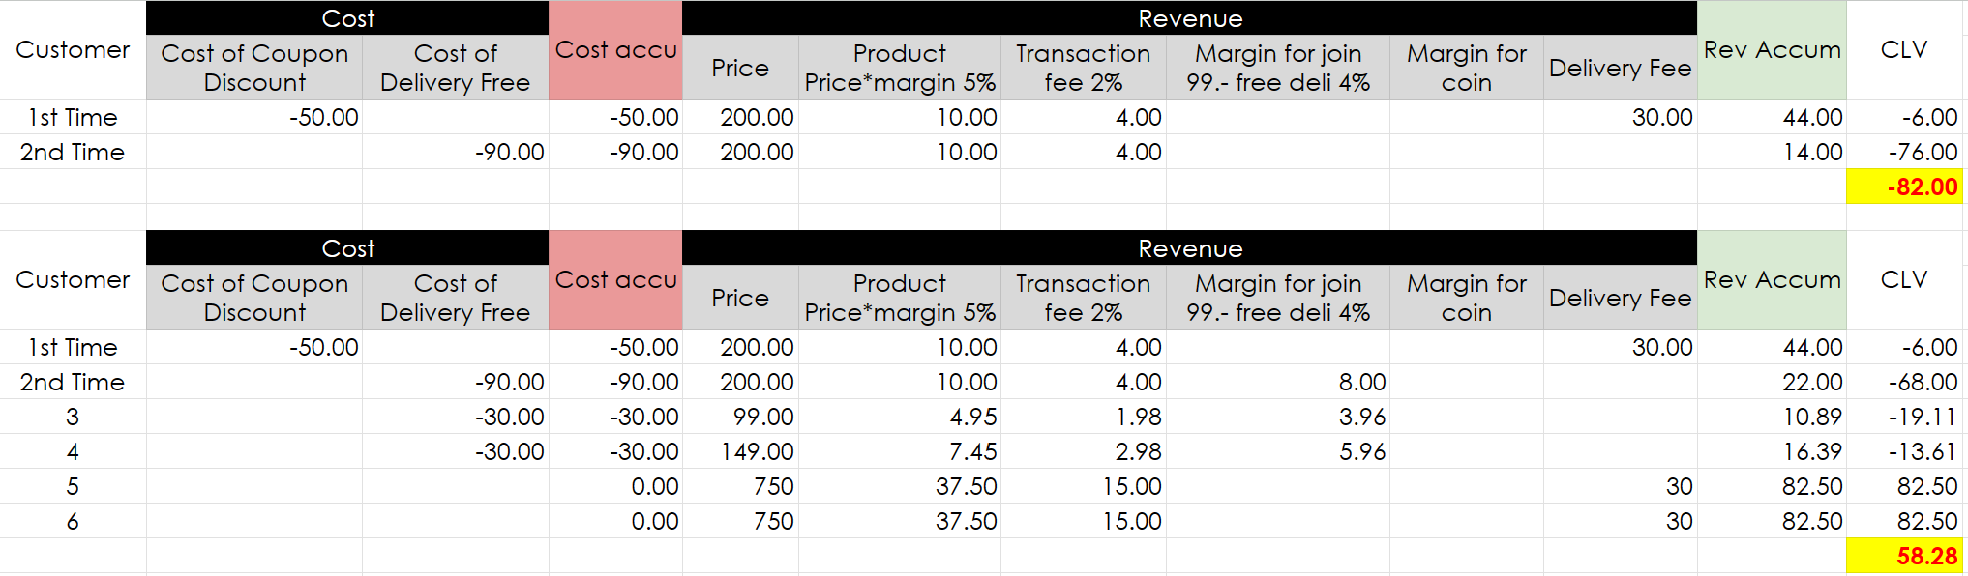
CLV : Calculation

Slide 15
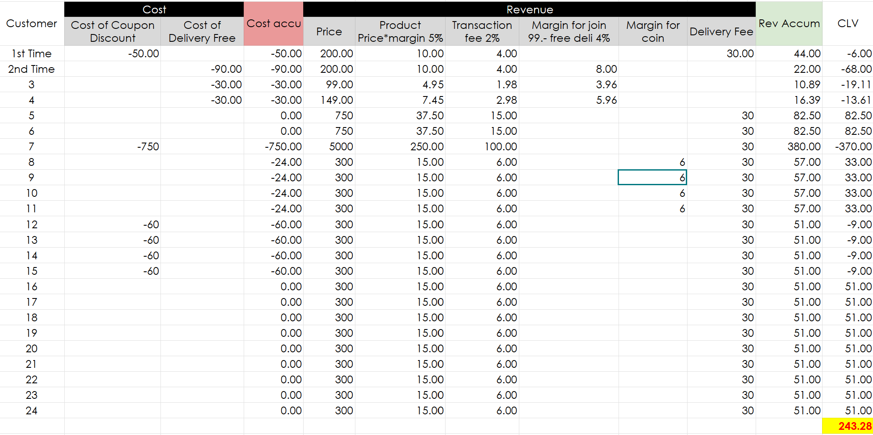
CLV : Calculation

Slide 16
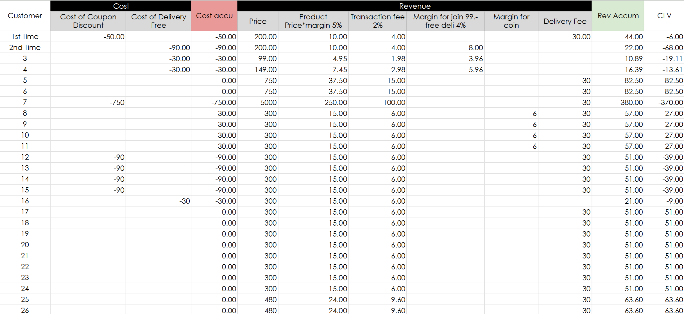
CLV : Calculation

Slide 17
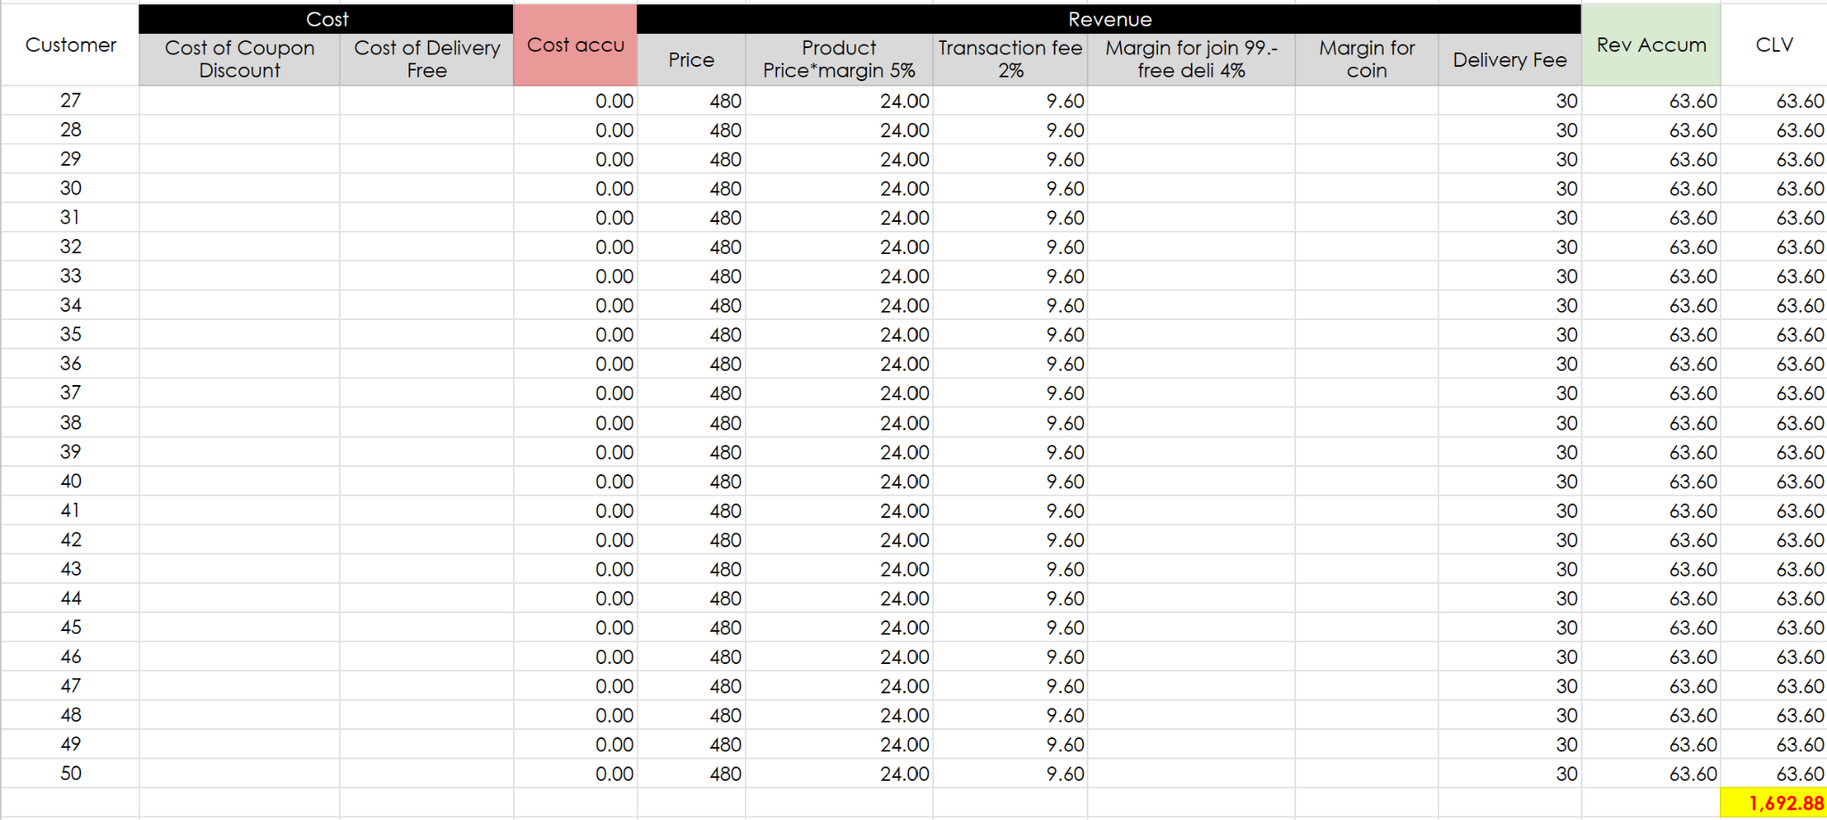
CLV : Calculation

Slide 18
SCORING

Slide 19
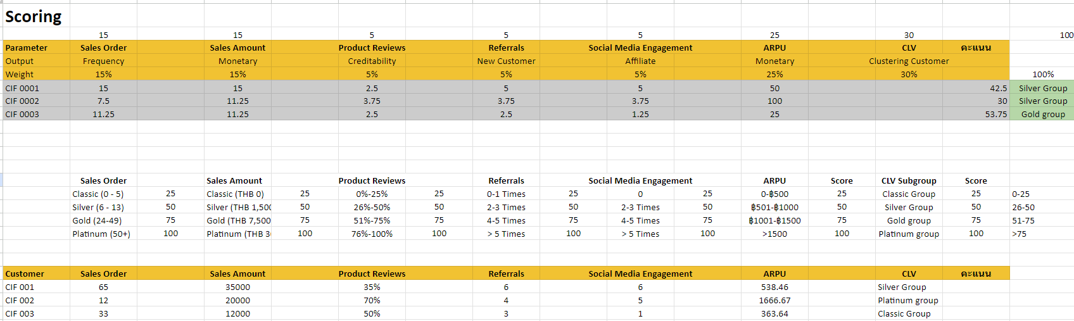
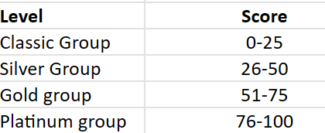
Scoring
Parameter score
Data

Slide 20

Thank You
Team Members
6510424001 ภูเบศ อุ่นกุศลภักดี
6510424002 นันท์นภัส สิงห์แก้ว
6510424004 พิริยะ ถวายจีน
6510424020 ชนภัทร์ เอกกมลวิวัฒน์
6510424027 เมธาวี มุ่งเจริญ

